Slide 1

FACE RECOGNITION
SWE 557
Artificial Intelligence and Machine Learning
(Comparing Logistic, SVM and Naive Bayes algorithms)
Supervised by: Professor John Kim
Prepared by: Savita Khadse(27565948)
Samee Peerzade(59638609)

Slide 2
Objective
Face recognition technology is used to find a series of data of the same face in a set of training images in a database from the incoming image.
The findings of this work would be useful for identification of a suitable machine-learning algorithm out of Logistic, Support Vector Machine and Naive Bayes algorithms to achieve highest face recognition accuracy.

Slide 3
Where it is used?
In social media platforms like facebook, Instagram, Twitter
Law enforcement agencies use it to identify suspects or track down missing persons.
Tech companies use it to allow consumers to easily unlock their devices and many more….

Slide 4
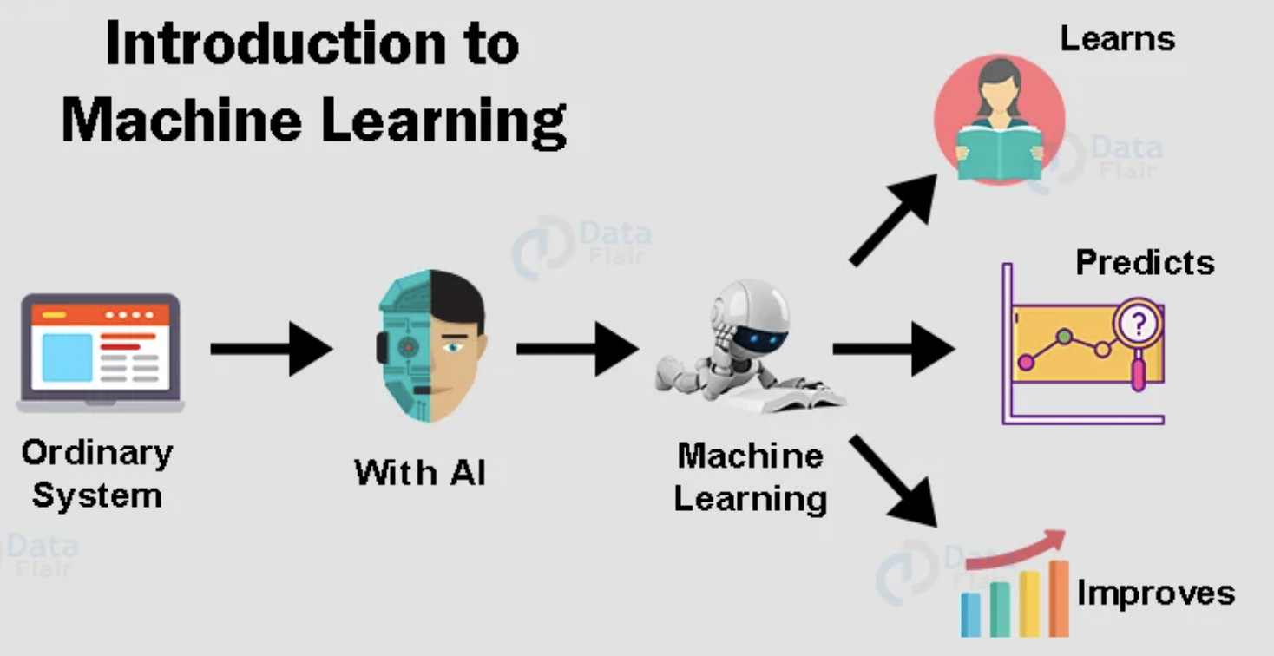
What is Machine learning?
*Machine learning is the subset of Artificial Intelligence that uses data, algorithms and statistical techniques to build intelligent systems who learns by themselves and improves. Machine Learning is the science of making computers learn and act like humans by feeding data and information without being explicitly programmed!
Steps in Machine learning….
Define Objective
Collect data
Prepare Data(bad in bad out)
Select Algorithm
Train Model
Test Model
Predict
Deploy

Slide 5
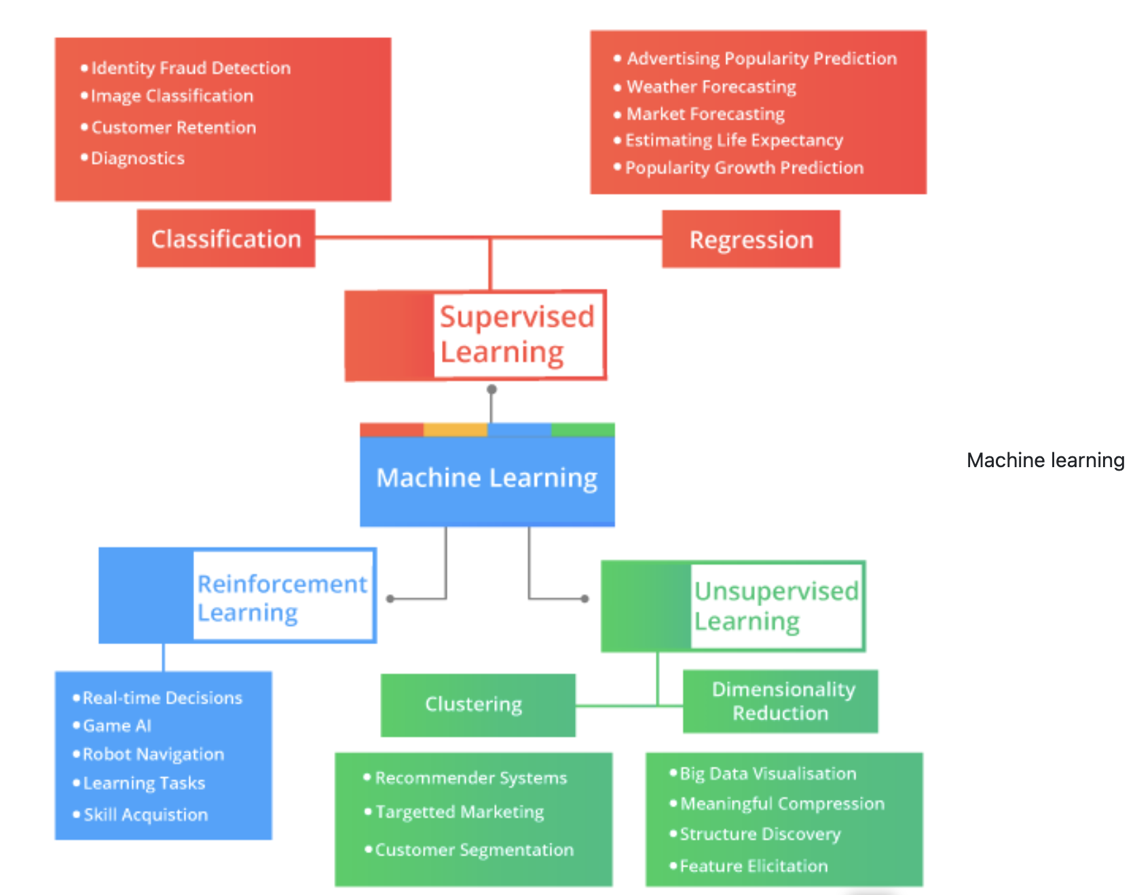
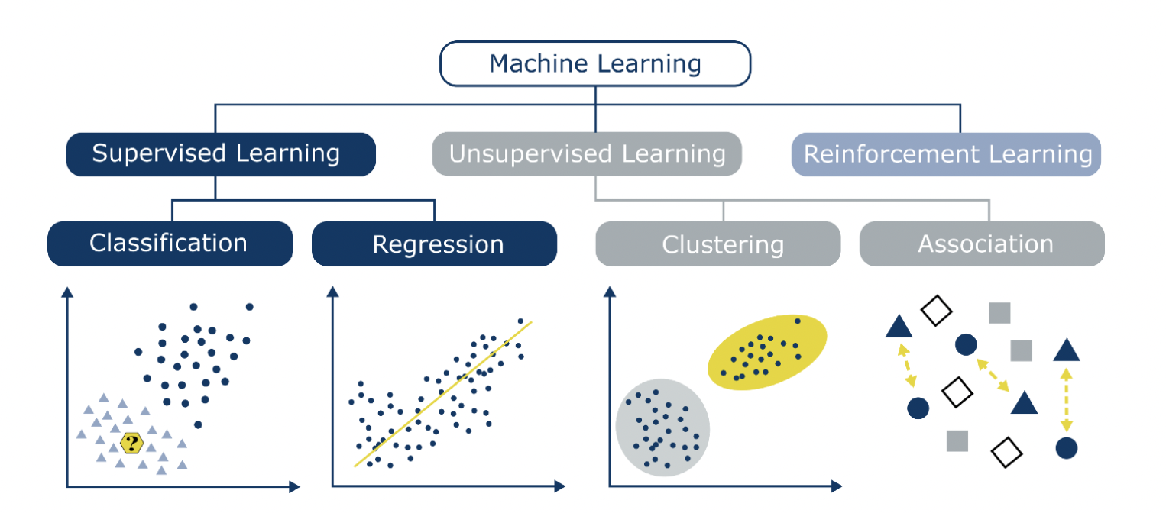
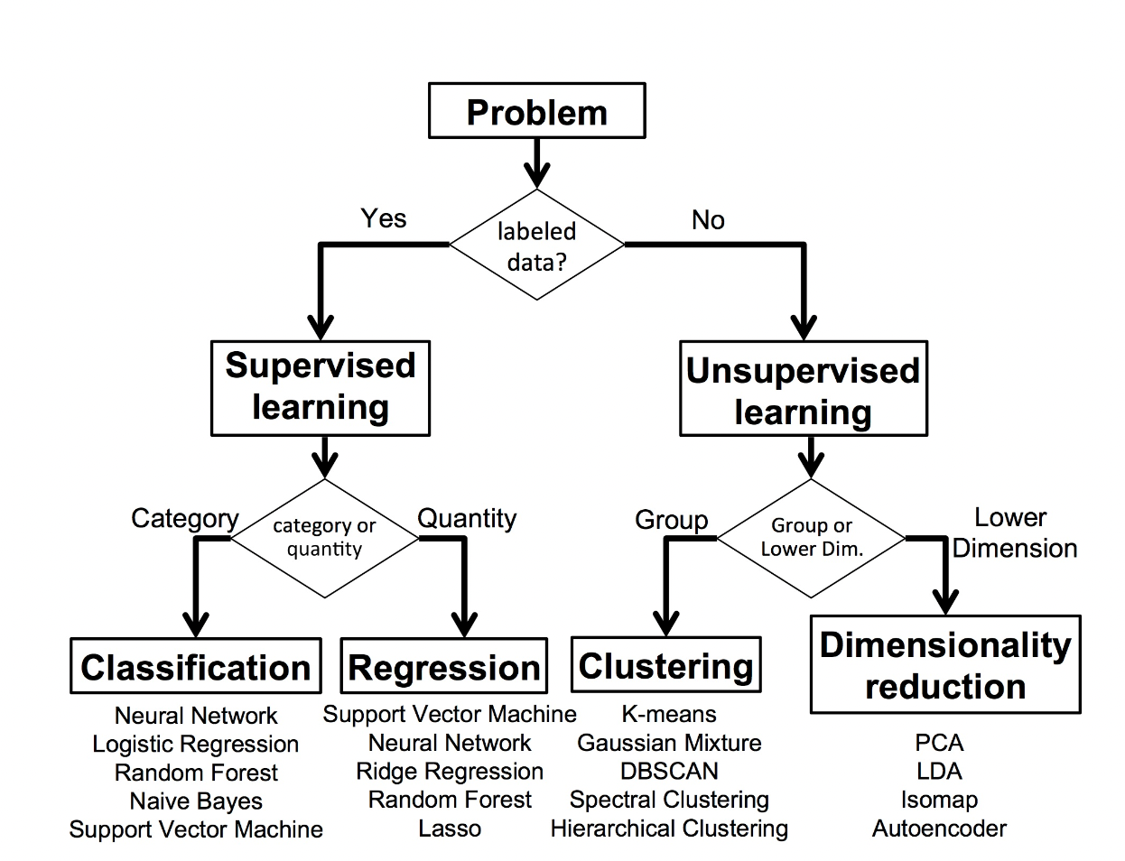

Slide 6
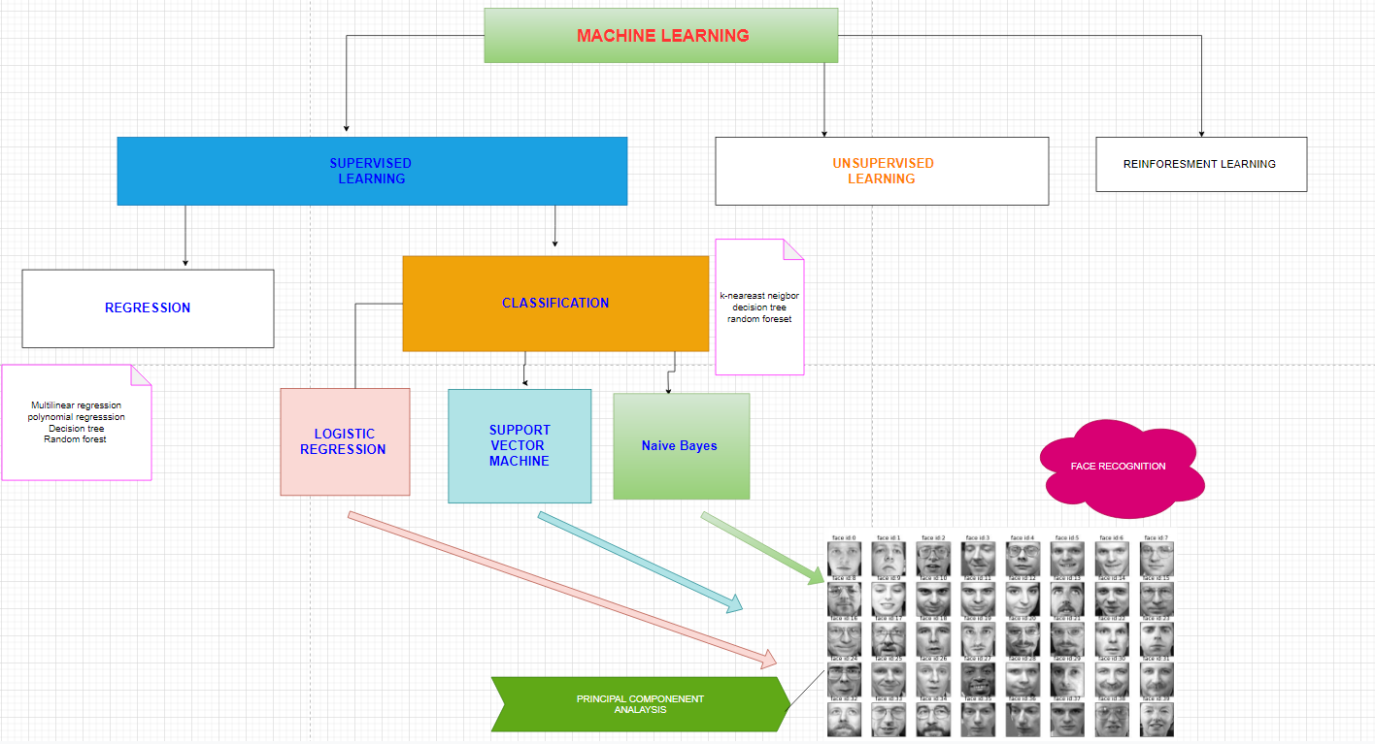
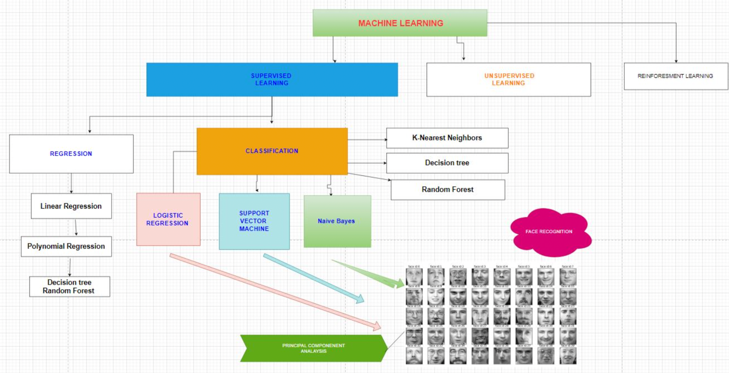
Principal Component Analysis(PCA)
Principal Component Analysis

Slide 7
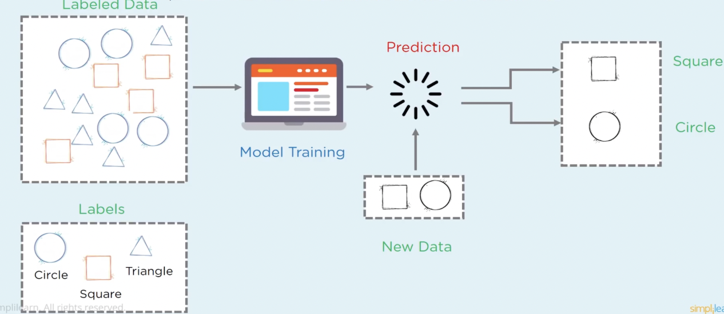
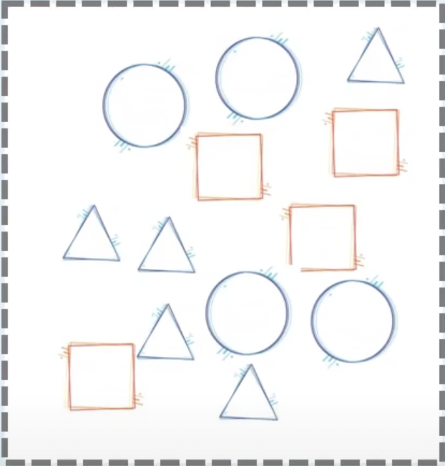
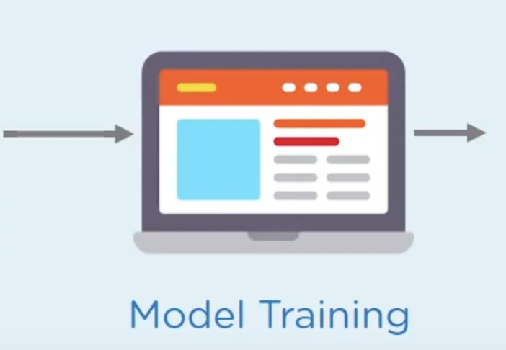
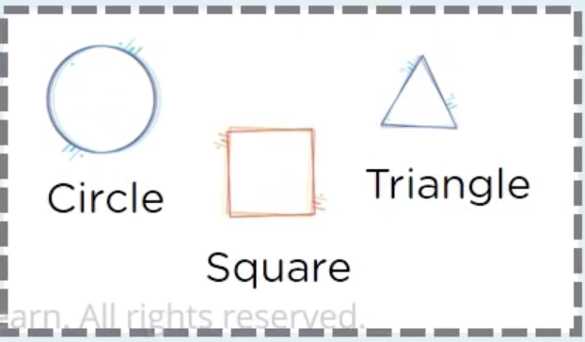
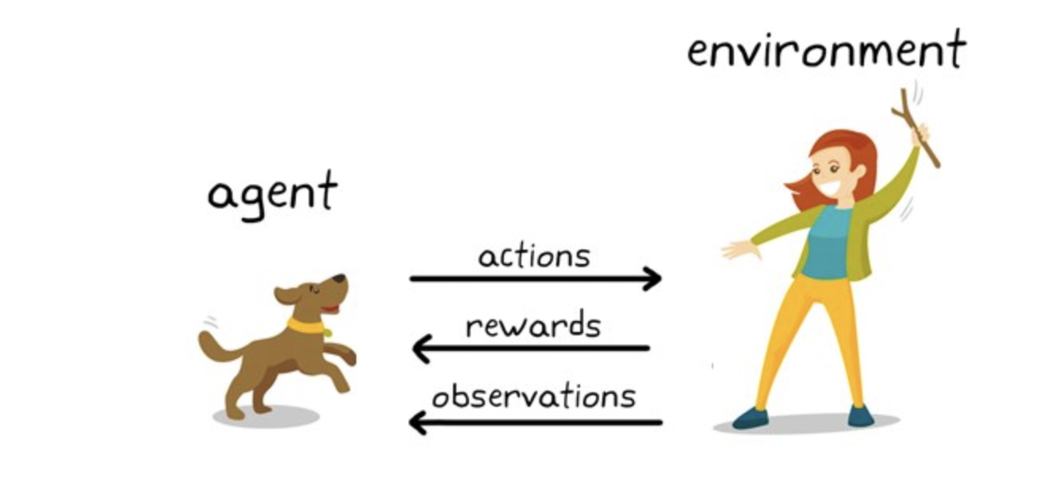
Supervised learning is a method used to enable machines to classify/ predict objects , problems or situations based on labeled data.
In Unsupervised Learning, there is no labeled data and no supervision. The algorithm identifies the patterns within the dataset and learns them. The algorithm groups the data into various clusters based on their density. One example of this type of Machine learning algorithm is the Principle Component Analysis(PCA).
Reinforcement learning is an important type of machine learning where system learns how to act in an environment by performing actions and seeing the results. The aim of Reinforcement Learning is to direct the agent towards maximizing rewards and reach its goal. This takes place in a dynamic environment where the agent has to chart its way to the goal through a series of trials and errors.

Slide 8
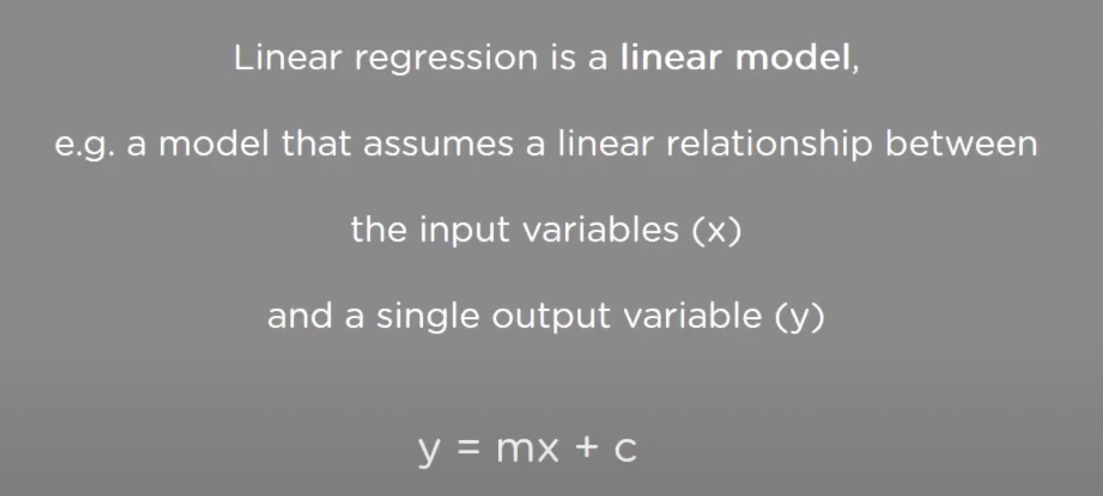
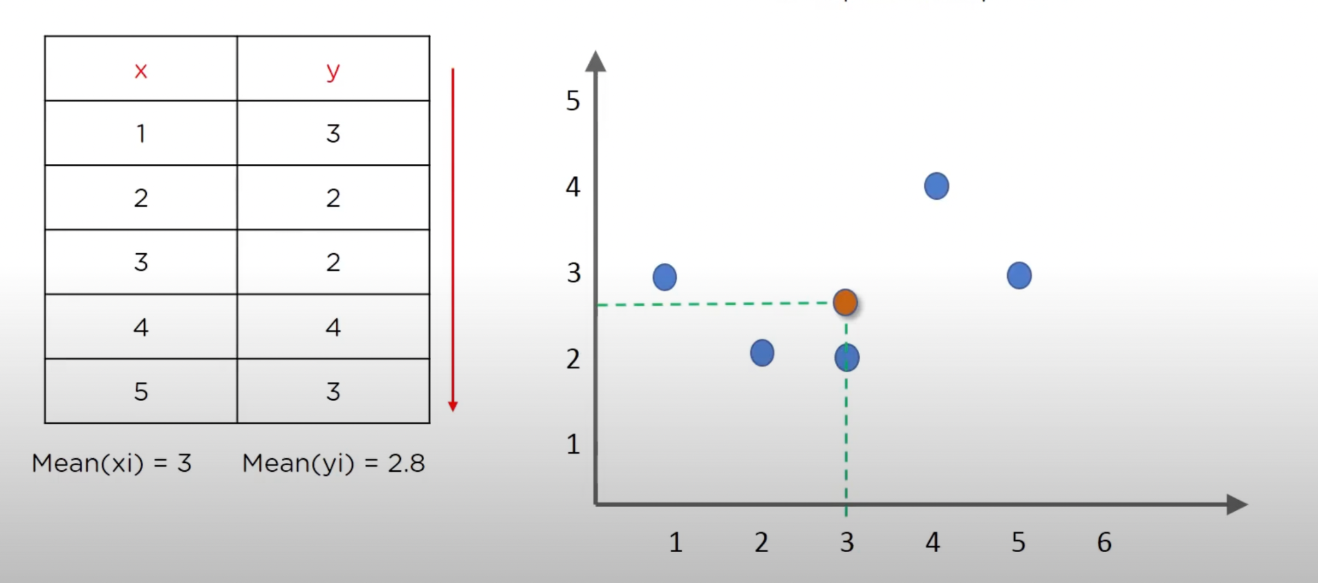
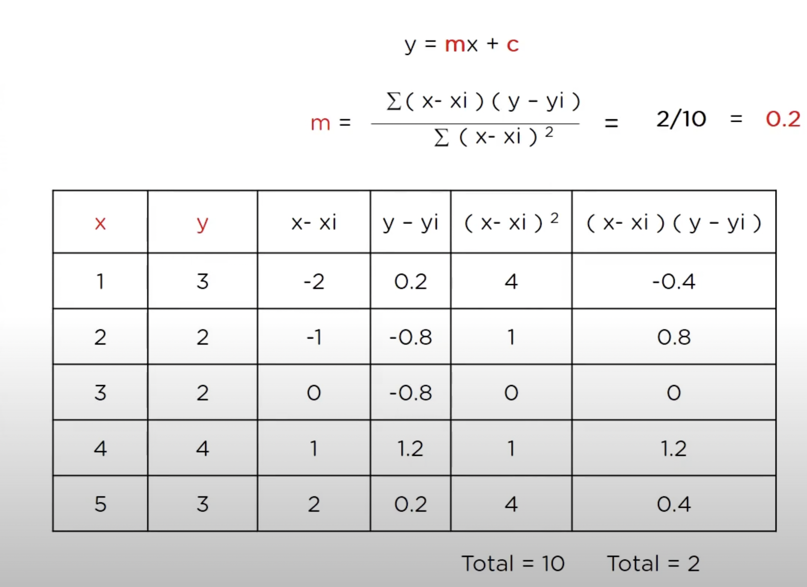
Linear Regression
Linear Regression is one of the most well known and understood algorithms in the field of statistics.
To find this equation for our data, we need to find slope(m) and coefficient(c).
(Mean of x) xi=3
(Mean of y) yi=2.8

Slide 9
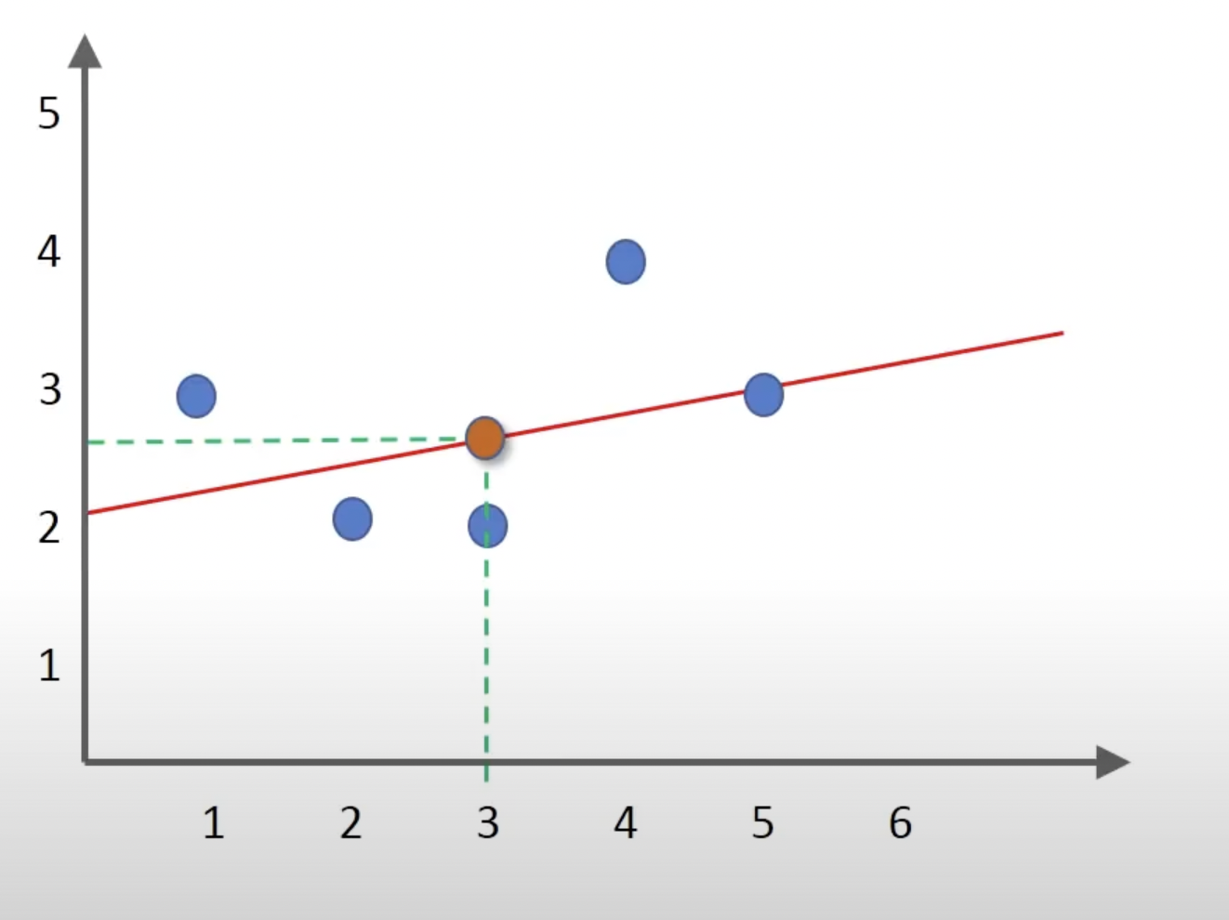
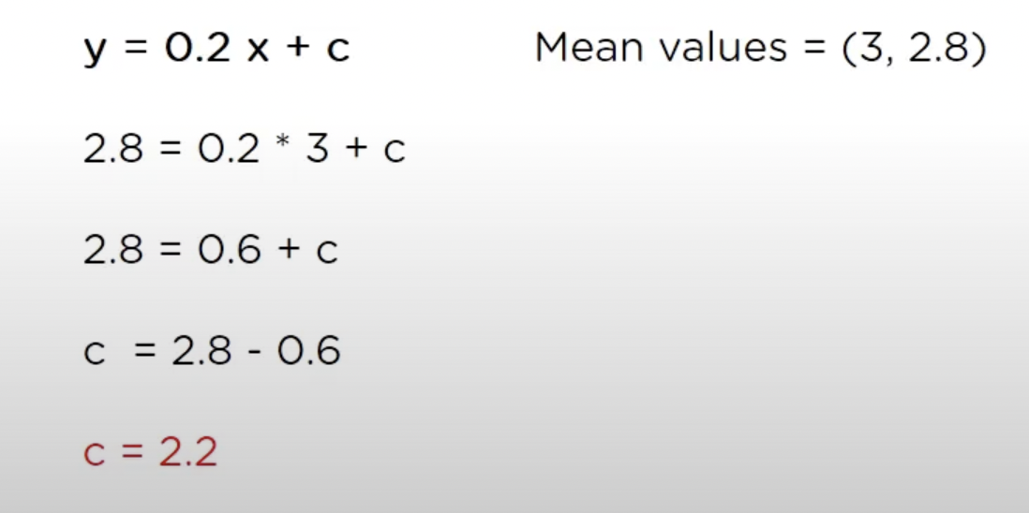
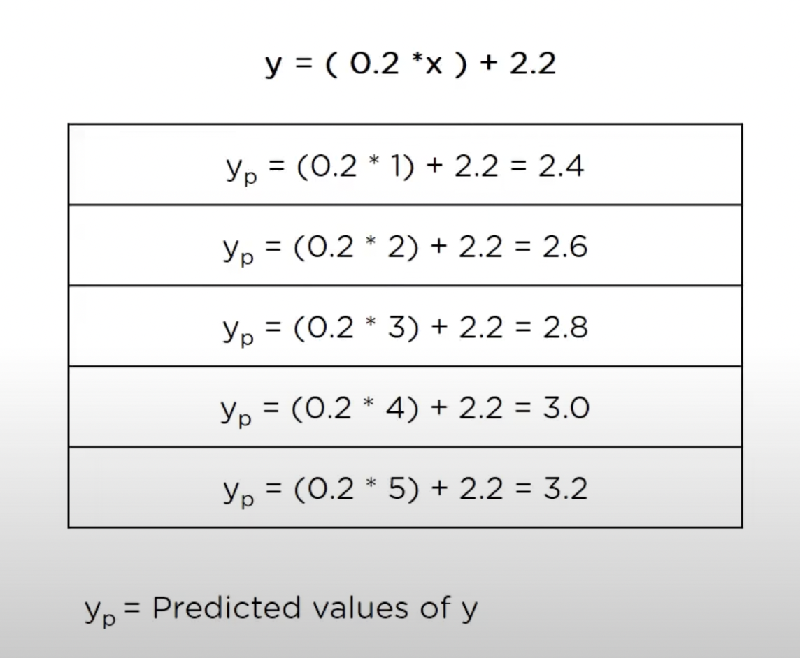
Now let’s predict the values of y using x ={1,2,3,4,5}

Slide 10
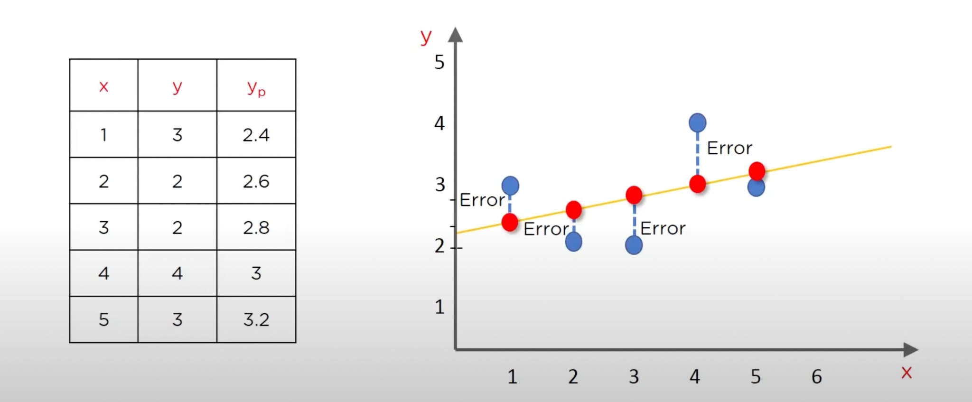
So our goal is to reduce this error! There are lots of ways to minimize this error(distance between the line and the data points like sum of squared errors, Sum of Absolute errors, Root Mean squared error etc.

Slide 11
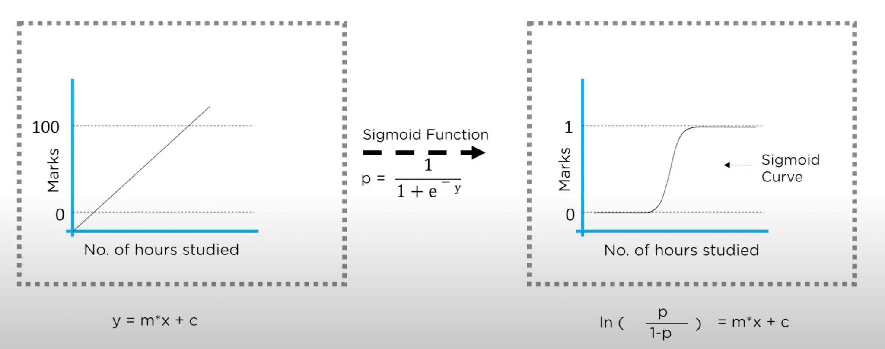
Classification Algorithm
Classification algorithm is one of the most important aspect of supervised learning. We will discuss the various classification algorithms like logistic regression, naive bayes, Support vector Machines(SVM) in detail as we have used it in this project.
Logistic regression is algorithm is the simplest classification algorithm used for binary or multi-classification problems. Using linear regression we cannot divide outcome into categories and so in such cases we can use logistic regression and sigmoid function.
For example we have data of students marks vs hours of study as below:

Slide 12
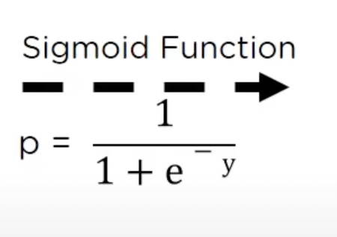
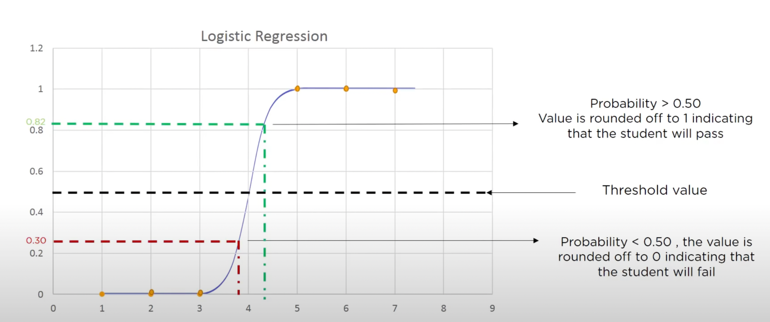
Logistic regression continued….
In this example, first graph we have linear regression where we can determine marks will increase as hours of study increases but to decide if student fails or pass using this data we need to use sigmoid function. y= ln(p/1-p) So, m*x+c = ln(p/1-p)
Here, depending on values of x we have created sigmoid curve and threshold value.

Slide 13
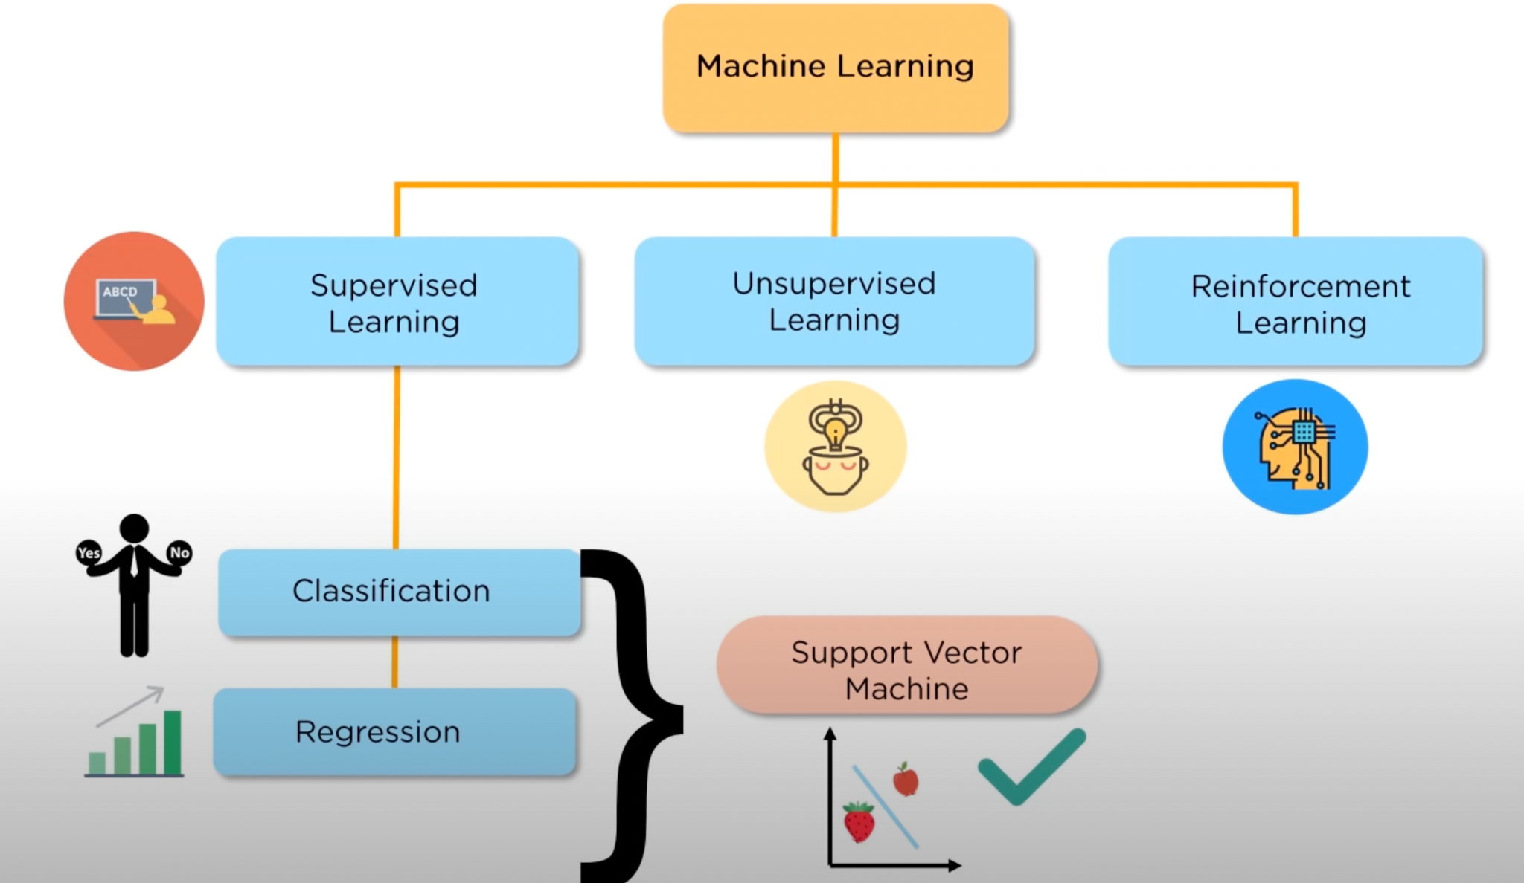
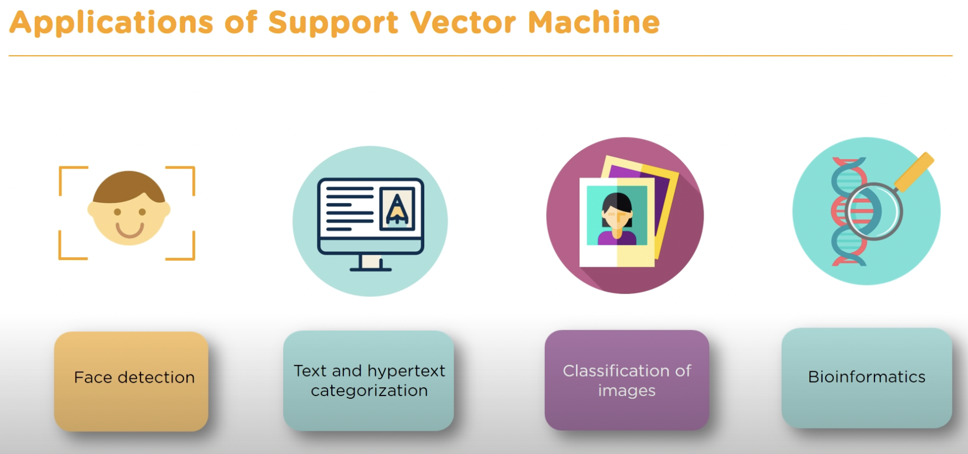
Support Vector Machine
Support vector Machine is a supervised learning method that looks at data and sorts it into two categories. It is the most popular algorithm for classification in Machine learning algorithms. The mathematical background is quintessential in building the foundational block for the geometrical distinction between the two classes.
While they can be used for regression, SVM is mostly used for classification.

Slide 14
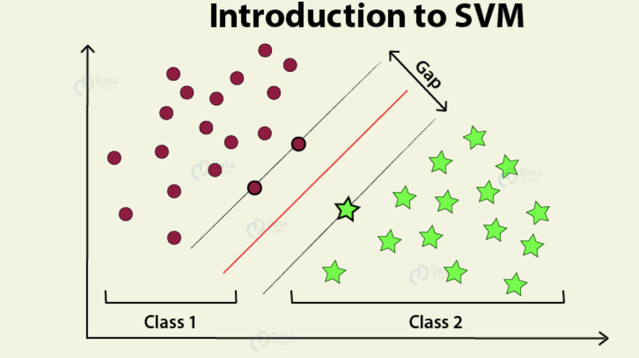
What is Support Vector Machine and how it works?
The basic principle behind the working of Support vector machines is simple – Create a hyperplane that separates the dataset into classes. We have to find the points that lie closest to both the classes. These points are known as support vectors(R1, R2 and G1). The distance between the points and the dividing line is known as margin. The aim of an SVM algorithm is to maximize this very margin. When the margin reaches its maximum, the hyperplane becomes the optimal one. Once we create optimal hyperplane we can easily predict on which side our new data fits in. SVM also helps in curse of dimensionality, where we need to decide a hyperplane based on huge amount of support vectors. Also, Regularization parameter or lamda helps in overfitting and underfitting problems.
Margin
Hyperplane
R2
Marginal hyperplane
G1
R1

Slide 15
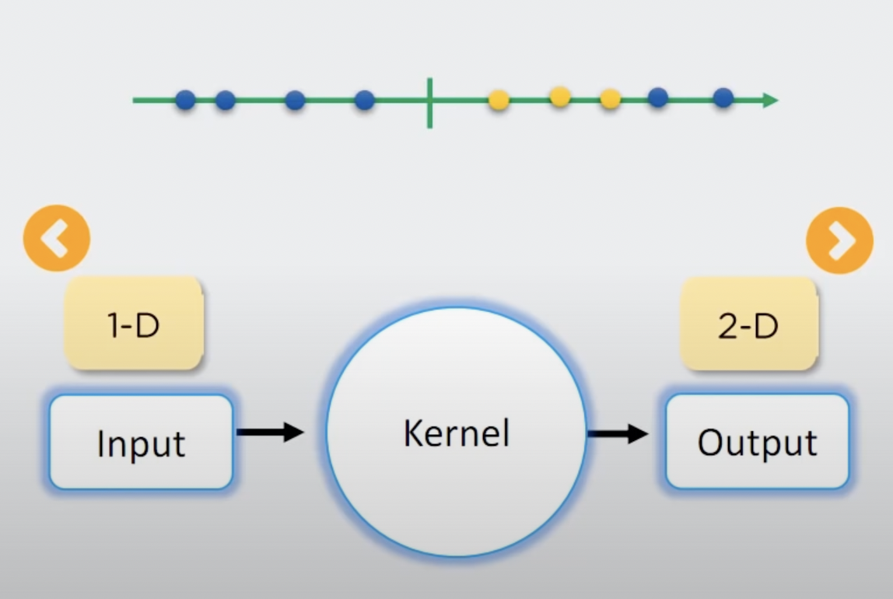
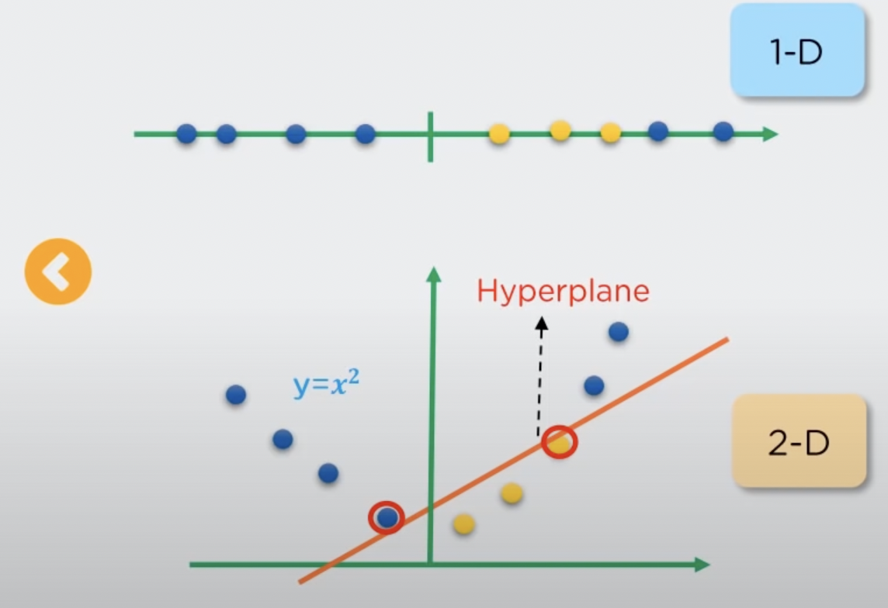
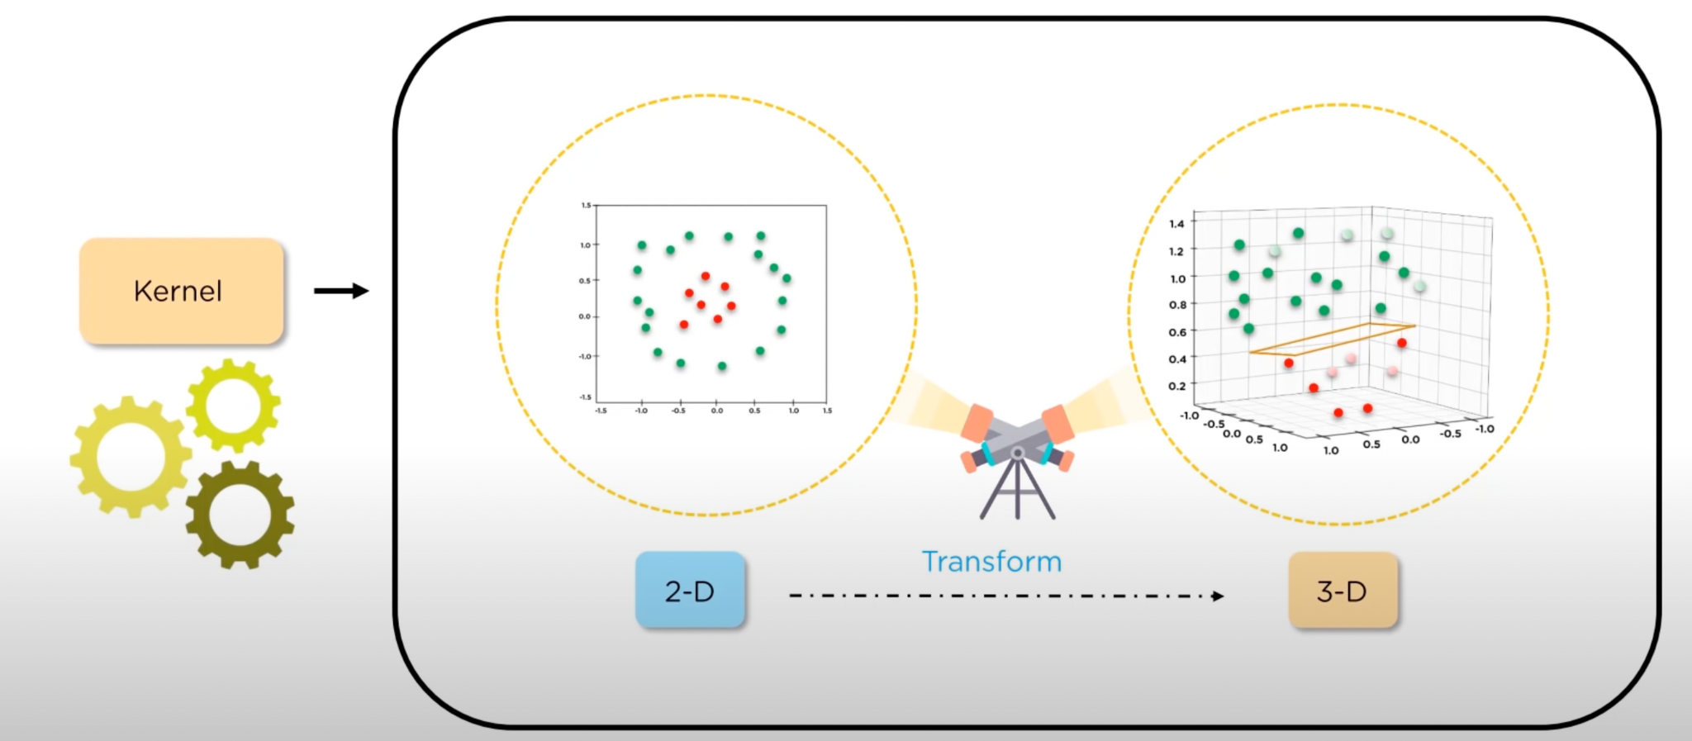
We have seen example of 2D data previously but when our data is in 1D we need kernel to convert data from 1D to 2D.

Slide 16
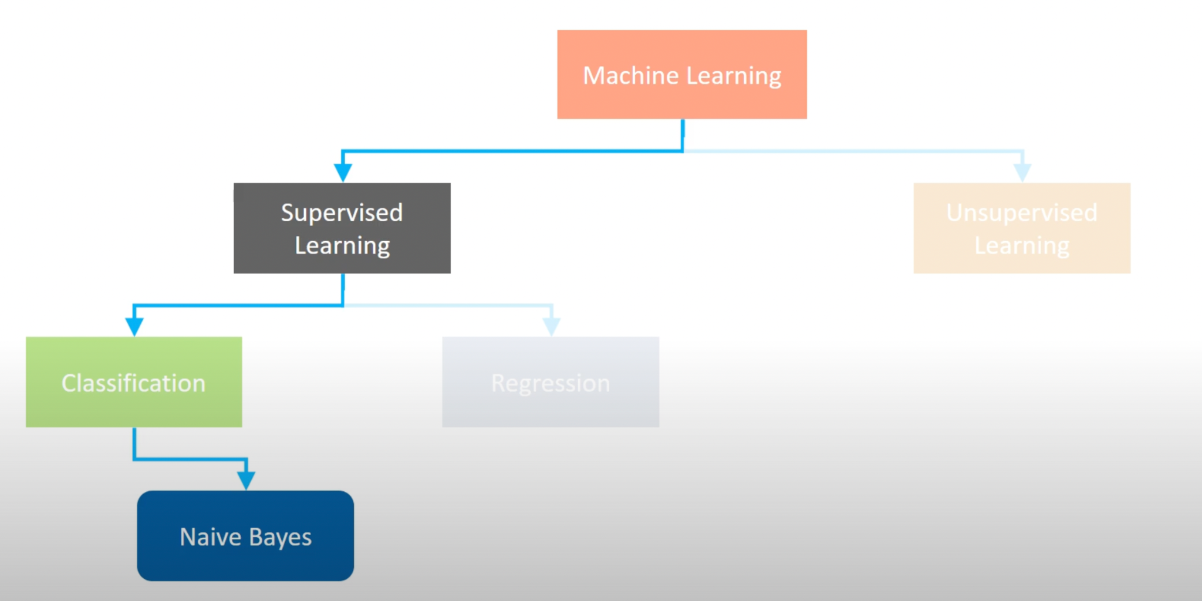
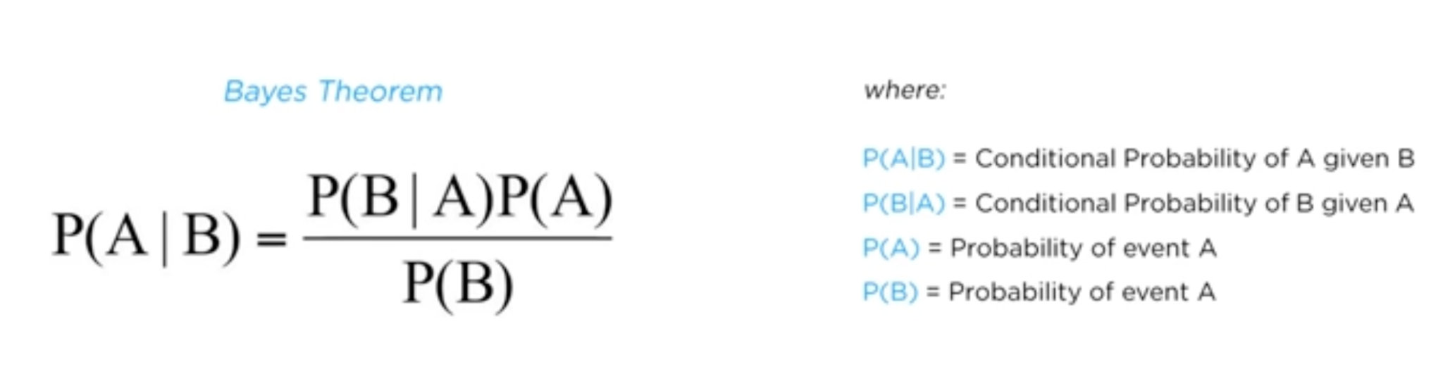
Naive bayes
Naive Bayes is one of the powerful machine learning algorithms that is used for classification which helps in building the fast machine learning models which will make quick predictions. As the name suggests, this algorithm works on the principles of conditional probability as given by the “Bayes’ Theorem” which gives the conditional probability of an event A given B.

Slide 17


Naive bayes
Naive Bayes algorithm is useful for:
Naive Bayes is an easy and quick way to predict the class of the dataset. Using this, one can perform a multi-class prediction.
When the assumption of independence is valid, Naive Bayes is much more capable than the other algorithms like logistic regression.
Furthermore, you will require less training data.
Where it is used?

Slide 18
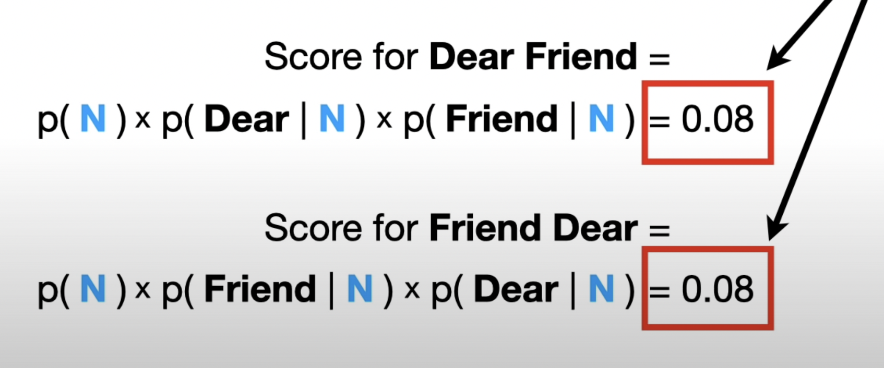
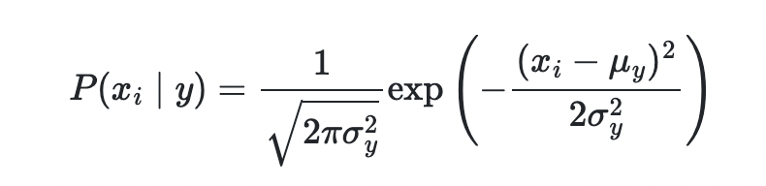
Naive Bayes methods are a set of supervised learning algorithms based on applying Bayes’ theorem with the “naive” assumption of conditional independence between every pair of features given the value of the class variable.
For example, in order to categorize email as spam or normal the order of words “Dear” and “Friend” doesn’t effect the result. The score for “Dear Friend” and “Friend Dear” is equal. So, Naive bayes ignores normal grammar rules.
Naive Bayes
Gaussian Naive Bayes
Multinomial Naive Bayes
Complement Naive Bayes
Bernoulli Naive Bayes
Categorical Naive Bayes
Out-of-core naive Bayes

Slide 19
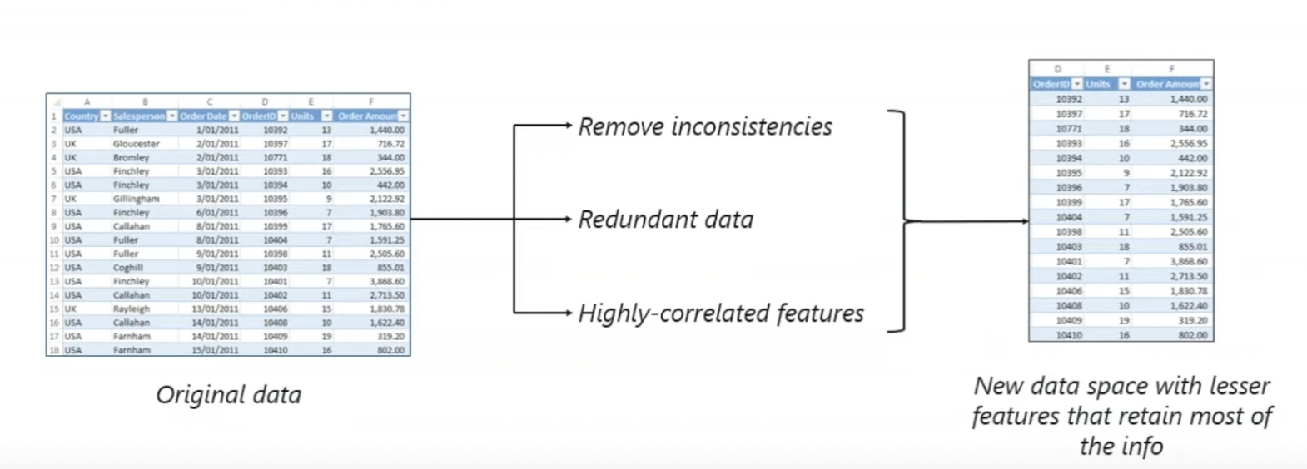
Principal Component Analysis (PCA)
Principal Component Analysis (PCA) is a dimensionality reduction technique that enables you to identify correlations and patterns in a data set so that it can be transformed into a data set of significantly lower dimension(Principal Components) without loss of any important information.

Slide 20
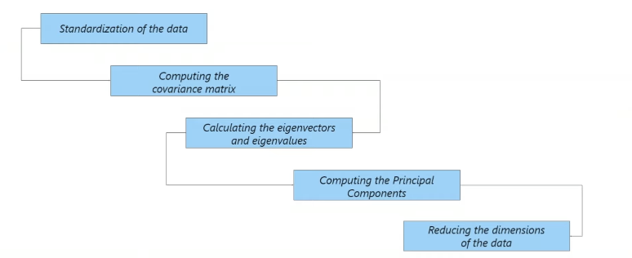
PCA continued…..

Slide 21
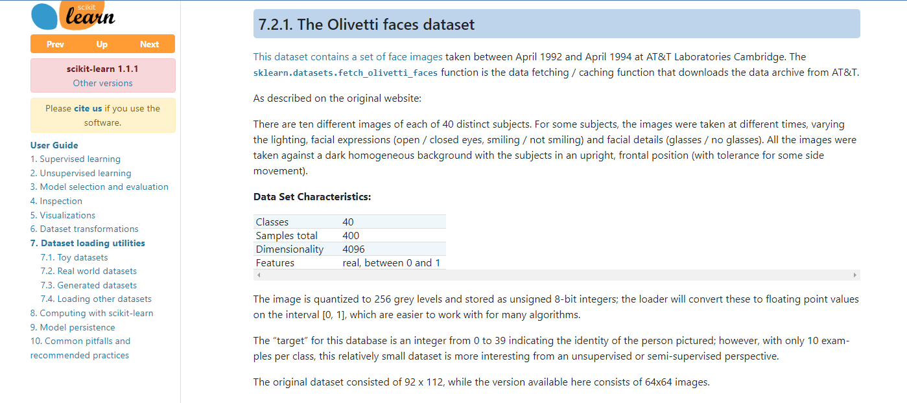
Problem Statement

Slide 22
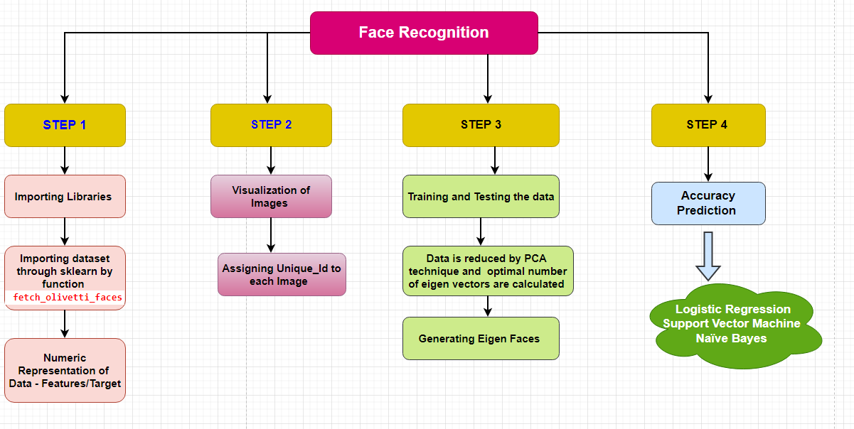
Project Flow Chart

Slide 23
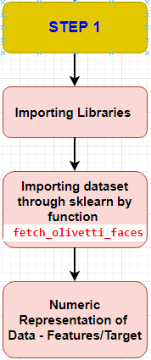
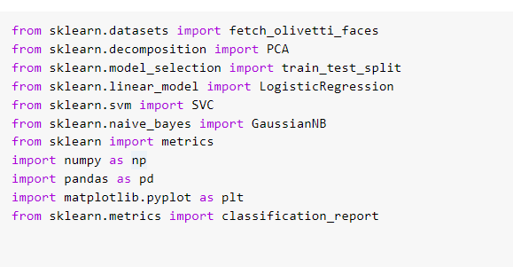
Step:1 Importing libraries
#Linear algebra
#data processing, CSV file I/O

Slide 24
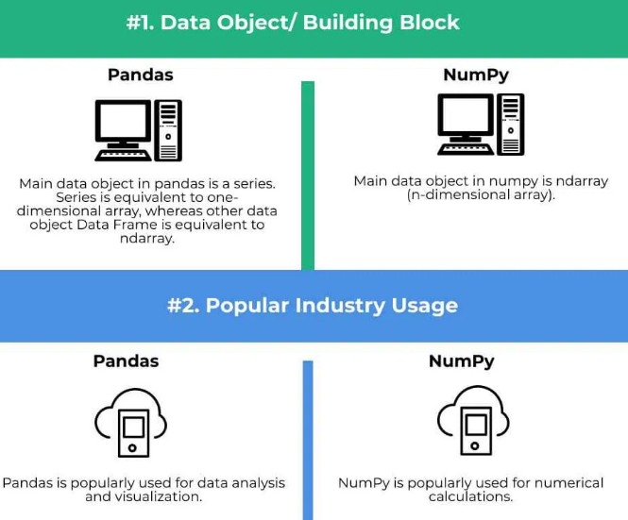
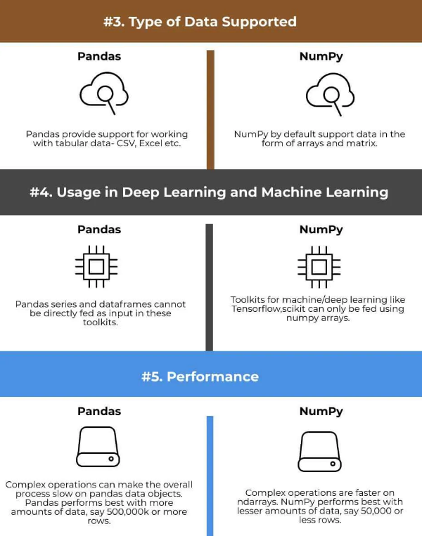

Numpy/pandas/matplotlib

Slide 25
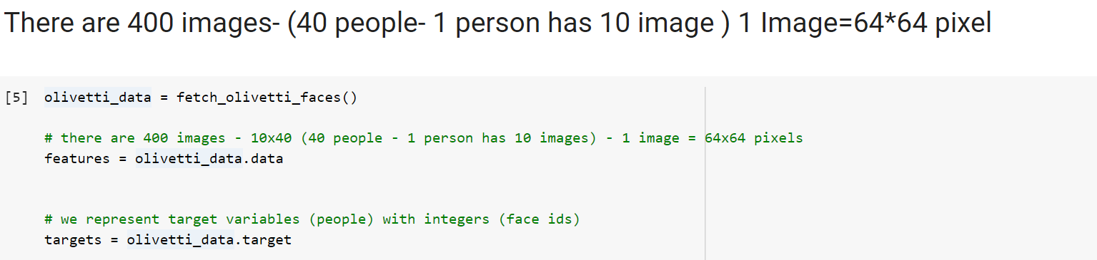
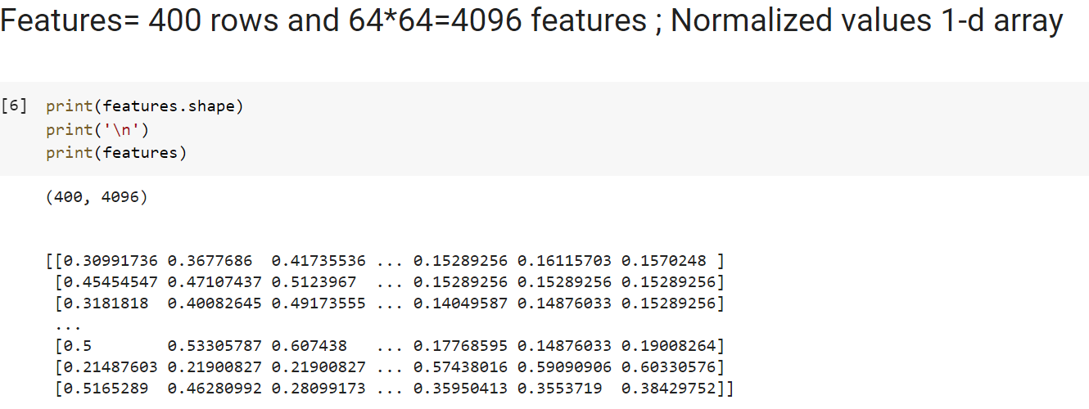
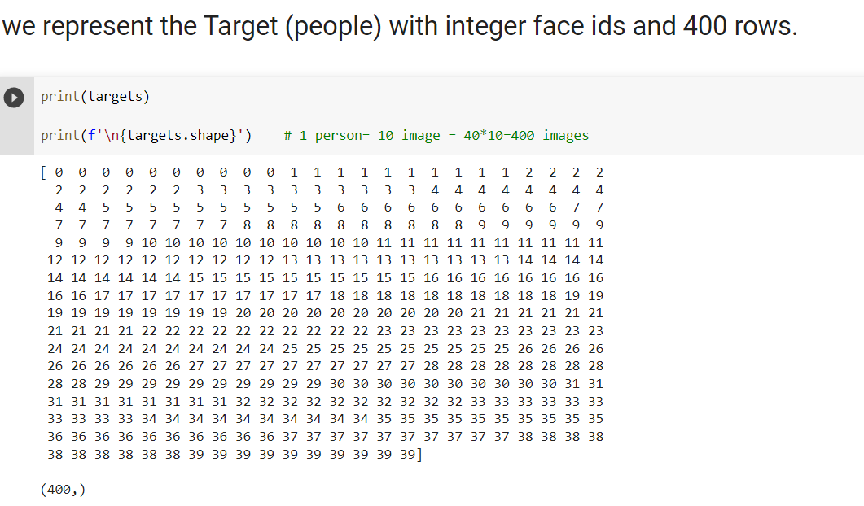
Numeric Representation Data

Slide 26
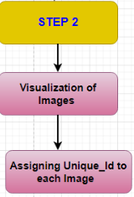
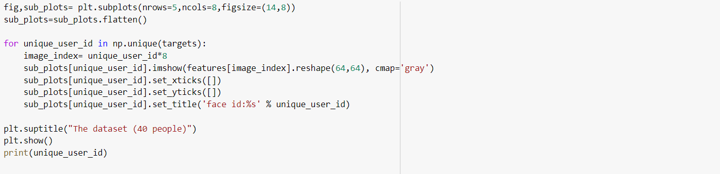
Step2: visualize

Slide 27
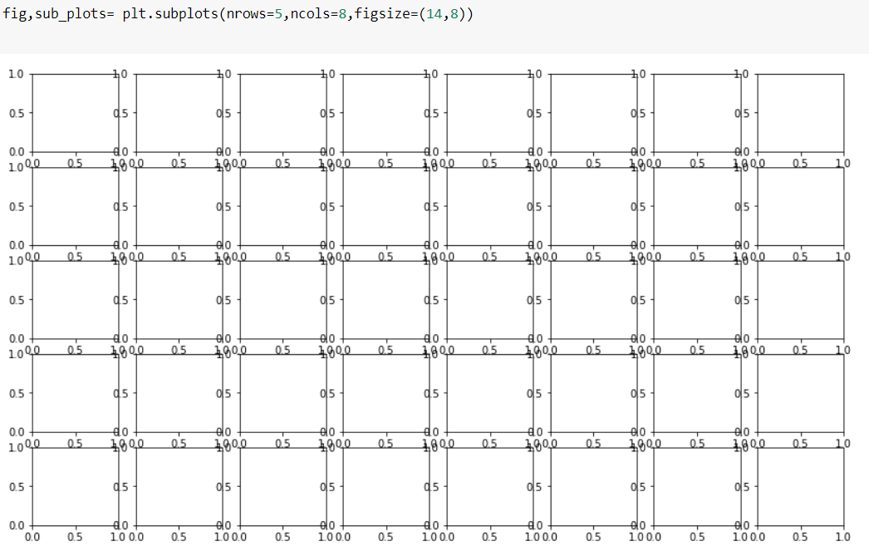

Slide 28
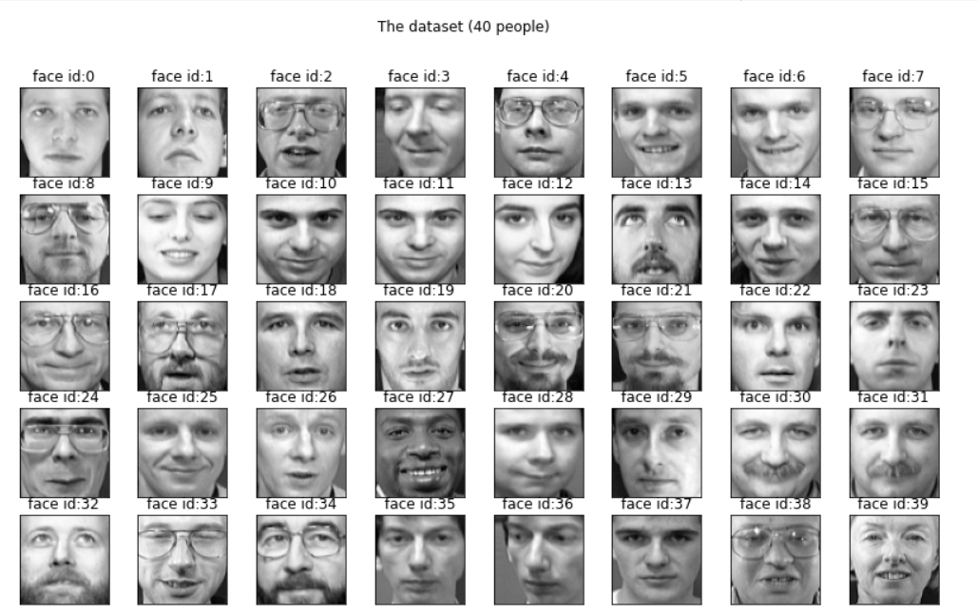

Slide 29
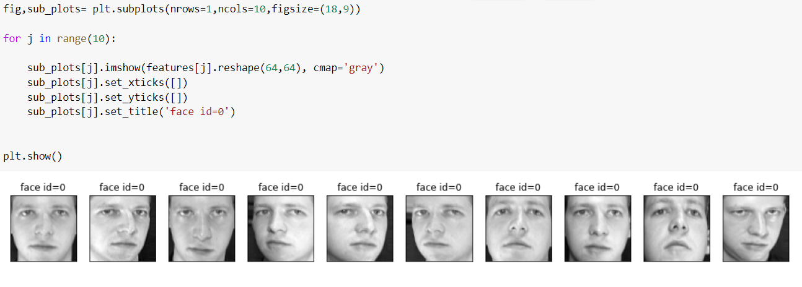

Slide 30
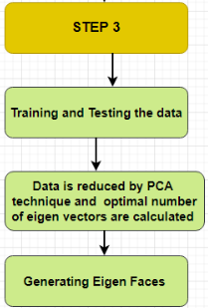
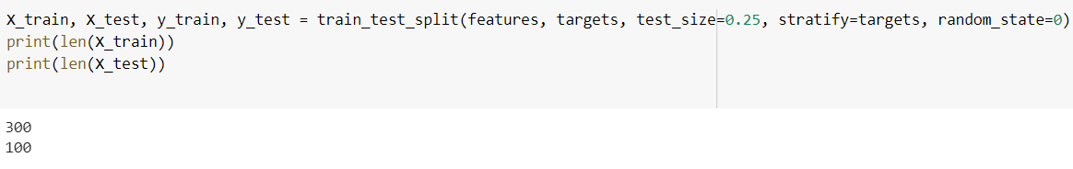
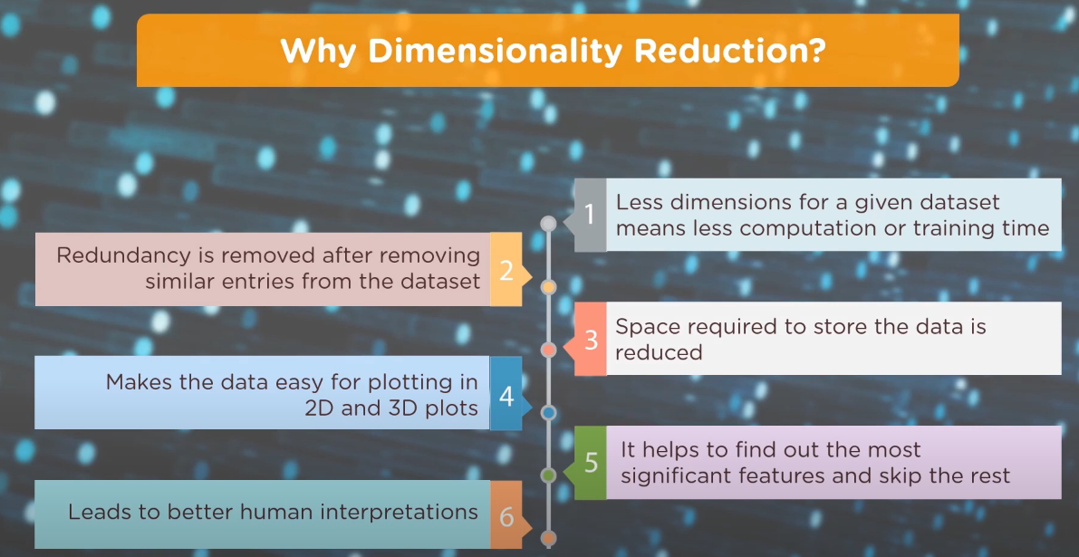
Step:3 Train and Test Data

Slide 31

How does PCA Works?

Slide 32


Slide 33

Eigen Faces

Slide 34


Slide 35

Flow Chart
Framework of Face Recognition

Slide 36

Step 4: Accuracy prediction

Slide 37

Confusion Matrix
A confusion matrix is a performance measurement method for Machine learning classification. It helps you to know the performance of the classification model on a set of test data so that the true values and false are known. It helps us find out how many times our model has given correct or wrong output and of what type. Hence, it is a very important tool for evaluating classification models.

Slide 38
CONCLUSION
Face recognition is a both challenging and important technique. Among all the biometric techniques, face recognition approach possesses one great advantage, which is its user-friendliness.
We hope this project provided a better understanding about face recognition, and we encourage the listeners who are interested in this topic to go to the references for more detailed study.

Slide 39
References…
Joseph Adewumi [Mar 26, 2019]-Understanding the Role of Eigenvectors and Eigenvalues in PCA Dimensionality Reduction
Matt Brems[Published on Apr 17, 2017]- A One-Stop Shop for Principal Component Analysis
Machine Learning Tutorial – All the Essential Concepts in Single Tutorial https://data-flair.training/blogs/machine-learning-tutorial/
Principal Component Analysis in Python | Basics of Principle Component Analysis Explained | Edureka
https://medium.com/@dareyadewumi650/understanding-the-role-of-eigenvectors-and-eigenvalues-in-pca-dimensionality-reduction-10186dad0c5c
http://lpsa.swarthmore.edu/BackGround/RevMat/MatrixReview.html
http://cda.psych.uiuc.edu/statistical_learning_course/Jolliffe%20I.%20Principal%20Component%20Analysis%20(2ed.,%20Springer,%202002)(518s)_MVsa_.pdf
THANK YOU!

